Slide 1
Workflow for Wearables: Study design, data processing, and analytic considerations for research using continuous health monitoring devices
Laura Kaizer, Sarah Schmiege, & Heather Smyth
Center for Innovative Design and Analysis (CIDA)
Department of Biostatistics and Informatics
Colorado School of Public Health
University of Colorado Anschutz Medical Campus

Slide 2
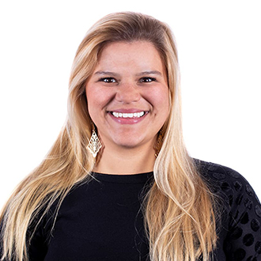

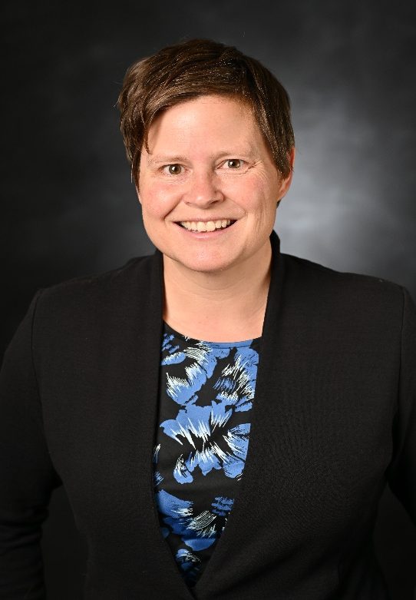
Meet the Instructors
Sarah Schmiege, PhD
Associate Professor
CIDA/Biostatistics and Informatics
Heather Smyth, PhD
Research Associate
CIDA
Laura (“Lala”) Kaizer, MPH
Research Instructor
CIDA

Slide 3
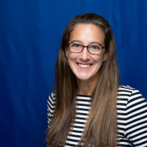
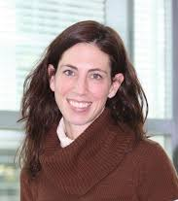
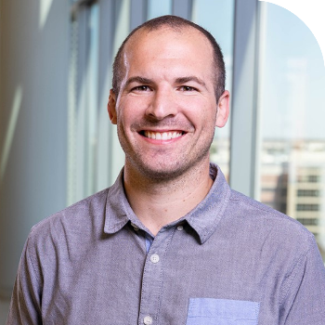
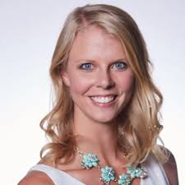
Acknowledgements
Clinical Collaborators
Grant Funding
NIH/NCATS Colorado CTSA Grant Number UM1 TR004399
Jen Blankenship, PhD
Victoria Catenacci, MD
Seth Creasy, PhD
Danielle Ostendorf, PhD

Slide 4
Course Outline
Background; Definitions; Research Questions (1:30-2:00pm, Schmiege)
Complex data processing needs unique to wearable technology data (2:00-3:00pm, Kaizer)
Appropriate visualization and summarization strategies (3:15-4:15, Kaizer)
Longitudinal analysis techniques and their interpretation (4:15-5:30, Smyth)

Slide 5

Course Audience
Course intended for consulting/collaborative statisticians and investigators
About you:
Role
Career stage (student, postdoc, early career, mid/late career)
Have you worked with wearables before?
Preferred software package(s)
Food you’re going to seek out in New Orleans

Slide 6
What do we mean by wearable data?
Wearable: Body-worn device that measures some aspect of human physiology and/or behavior
Activity trackers
Smartwatches
Biometric sensors
Smart Clothing
Provide continuous, real-time data in laboratory and real-world settings
Photo from Vijayan, Connolly, Condell, McKelvey, & Gardiner, 2021

Slide 7
Research Examples
Example 1: Influenza surveillance through wearables tracking pulse, physical activity, sleep and weather (Radin et al., 2020)
Example 2: Wearable wireless patch for remote monitoring of respiratory and cardiac rhythm in children with asthma following ED care (Javed et al., 2023); can be used in concert with electronic medication monitoring and remote feedback to improve adherence and clinical outcomes.
Example 3: Accelerometer to measure moderate/vigorous physical activity over 7-day period at baseline, 6, 12 and 18 months as part of a weight loss intervention (Catenacci et al., 2019).
Focus on wearable data for research purposes

Slide 8
Motivations for collecting data from wearable devices in research
Two big picture reasons:
Wearables are critical for answering the research question
Some questions can only be answered with continuous monitoring or remote assessment
Extensive sampling of observations provides opportunities to examine process at it unfolds in real time
Some behaviors or clinical outcomes can only be assessed through wearable technology (e.g., vital signs)

Slide 9
Motivations for collecting data from wearable devices in research
Two big picture reasons:
2. Wearables often provide a more valid assessment of outcomes
Can be considered objective (people overestimate behaviors that are healthy and underestimate those that are unhealthy)
With time intensive data, extreme outliers/observations more likely to be washed out
Opportunity to assess behaviors in non-laboratory situations

Slide 10
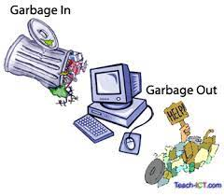

Motivations for collecting data from wearable devices in research
Needs to be nailed down early in study planning phases
Have a solid plan for why collecting and what will be done with it
Consider unit of analysis early in the process
What is the overarching analysis that will address research question; data are longitudinal but is the research question longitudinal?

Slide 11
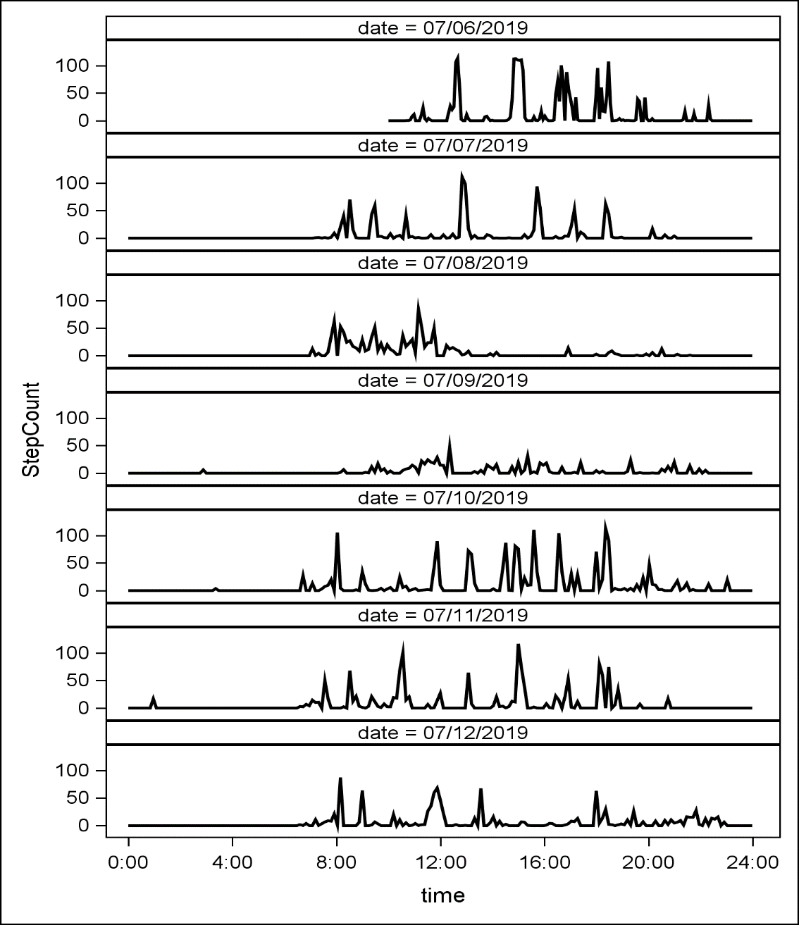
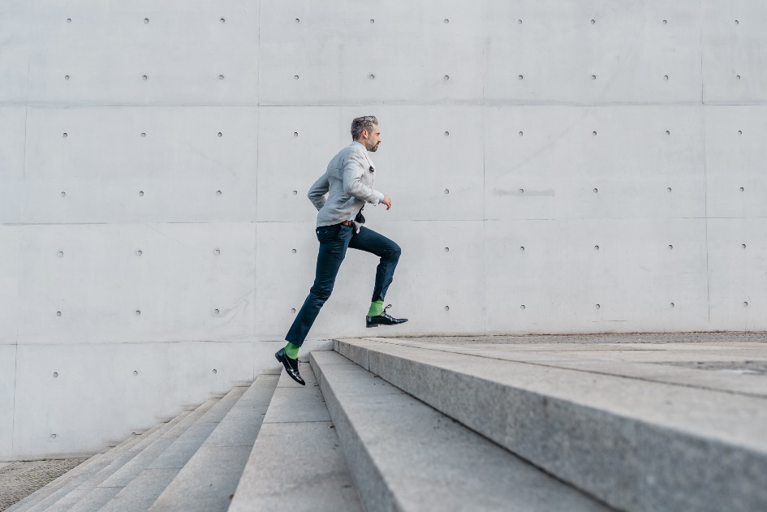
Daily step count

Slide 12
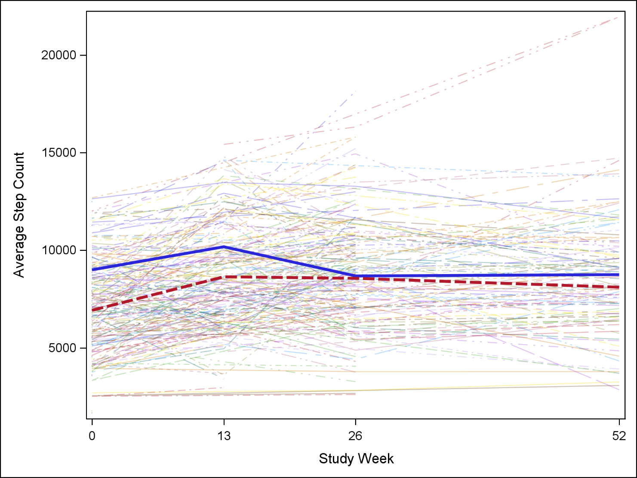
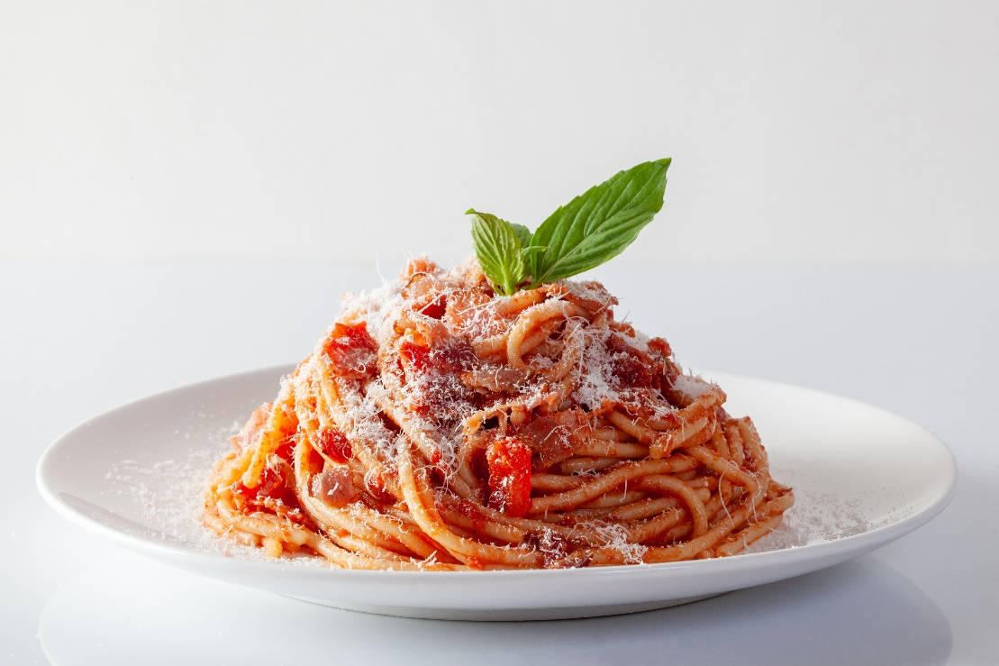
Aggregate step count by study week

Slide 13
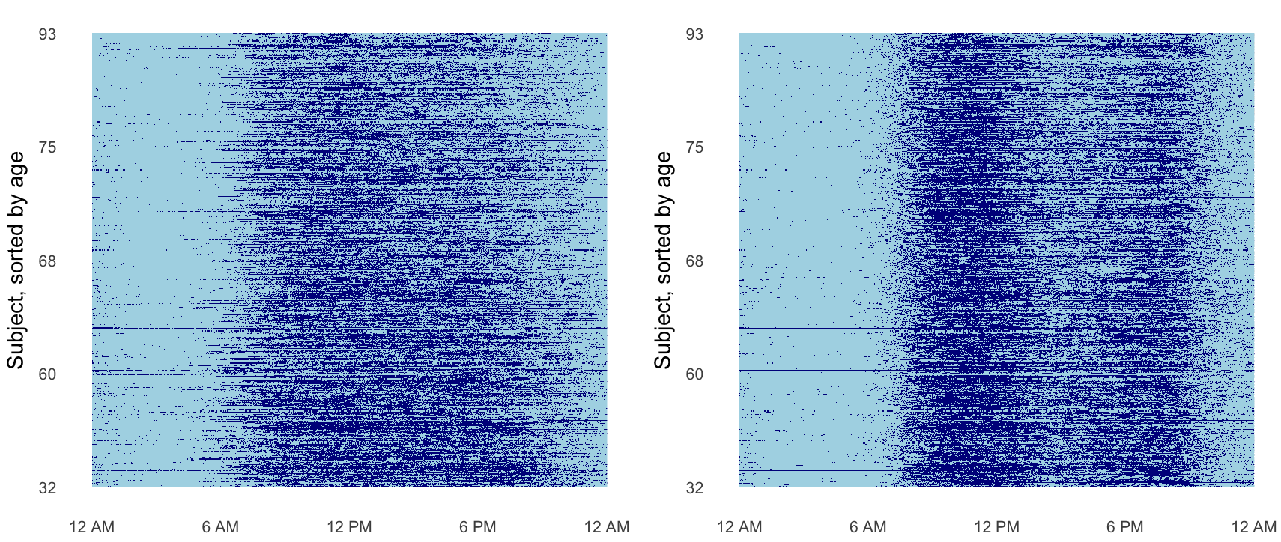
24 hour accelerometric rest-activity profiles
From http://juliawrobel.com/research.html

Slide 14
Consumer vs Research Grade
Reliability and Validity
Device Decision-Making
Suitability for Clinical Population
Specificity of Outcome Measurement

Slide 15
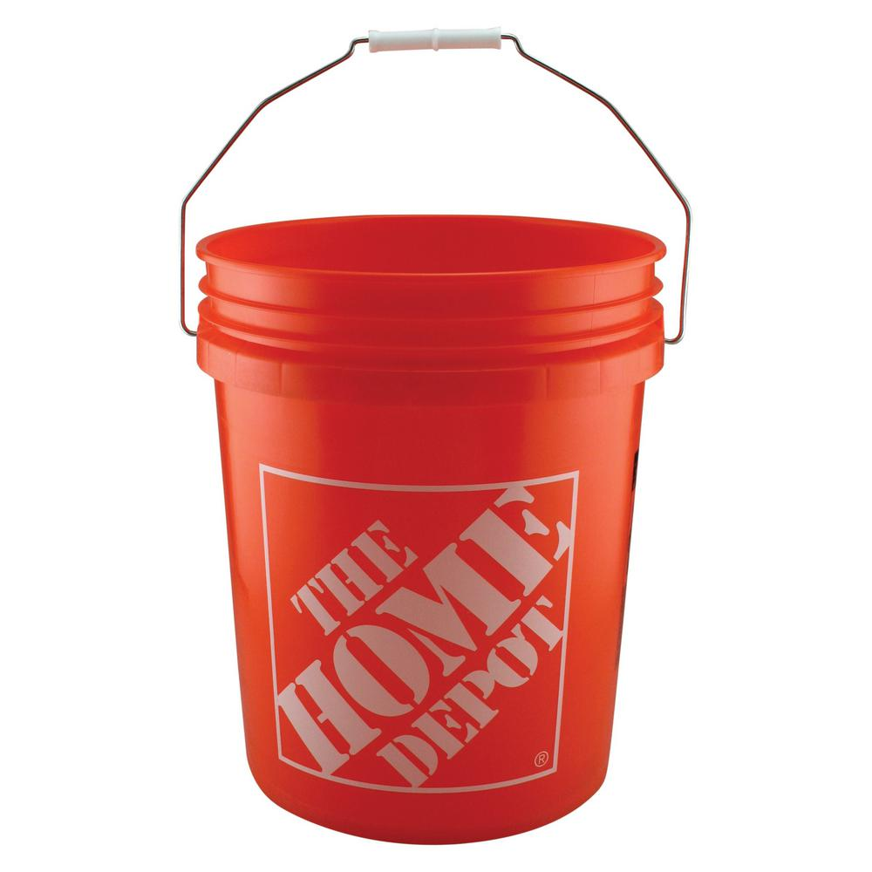
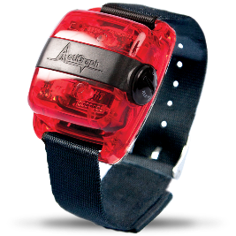
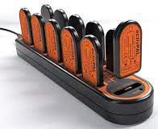
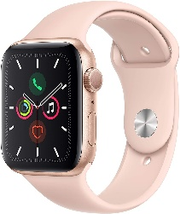
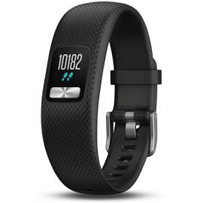
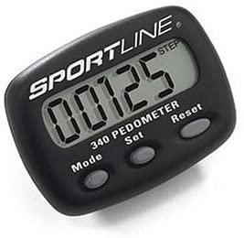
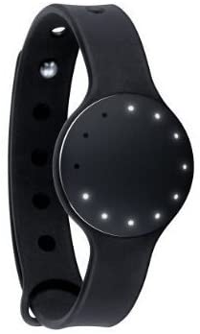

Device Type: Consumer vs Research grade
Commonly used monitors at CU-AMC
Advantages
Wearability/style
User interfaces
Inexpensive
Advantages
Accuracy and precision
Easy extraction of data
Software analysis suites
Consumer grade devices
Research grade devices
Disadvantages
Data extraction and analysis
Difficult to assess accuracy/precision
Stability of company
Disadvantages
Generally, less cool
Can be expensive
Slide Credit: Jen Blankenship

Slide 16
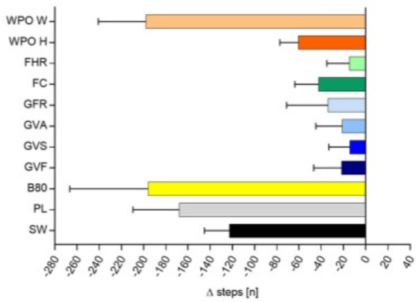
Device type: Reliability and Validity
From Fuller et al. JMIR, 2020.
From Wahl et al. Front Physiol 2017

Slide 17
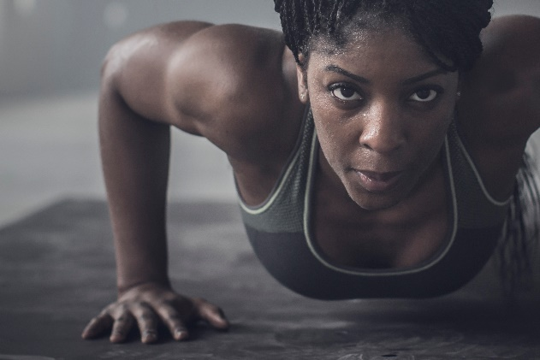
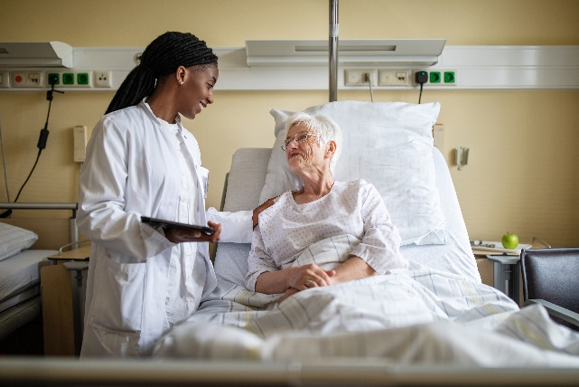
Device Type: Clinical Population
Who is wearing the monitor?
Population (barriers with using wearables)
Wear location
How long will monitor be worn for?
Duration of wear (battery life)
Wearability/user experience
Is the device valid for your specific population?

Slide 18
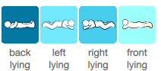

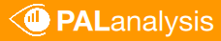
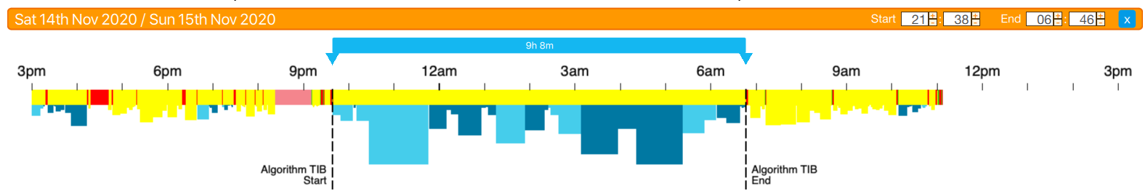
Device Type: Clinical Population
Young adult (no documented health conditions)
Slide Credit: Jen Blankenship

Slide 19
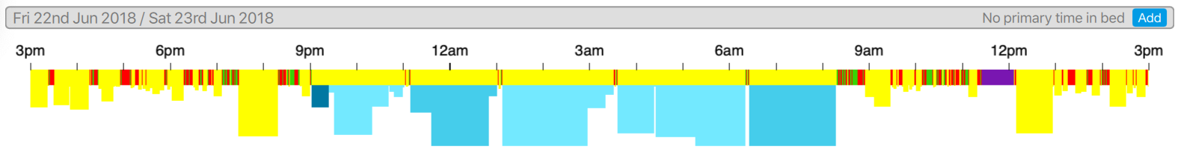
Device Type: Clinical Population - When Algorithms Break down
No detected sleep period
Older adult with heart failure
Interruptions in sleep period
Slide Credit: Jen Blankenship

Slide 20
Device Type: Specificity of Measurement Outcomes
Physical activity monitors measure acceleration and estimate physical activity
What are the meaningful metrics you want from the data?
Total steps
Step cadence
Light physical activity
Moderate to vigorous physical activity
Sitting time
Bottom line: Make sure your device can actually measure what you want to measure in your specific clinical population
Slide Credit: Jen Blankenship

Slide 21
Consumer vs Research Grade
Statistician vs PI role
in this process?
Reliability and Validity
Device Decision-Making
Suitability for Clinical Population
Specificity of Outcome Measurement

Slide 22
Wearable devices in research
Pros:
Objective, biologic measurement
Continuous monitoring, rich data
Remote data collection
Broader trial participation
Non-intrusive
Potential for improved equity
Considerations:
Expensive (devices and data processing)
Feedback loops – are wearables interventions?
Wash out period
Unit of measurement
Is the device suitable for participants being studied, clinically and practically
Battery life/wearability; device malfunction
Data security and privacy concerns
How to transfer and process data
Processing time and efforts
Role in statistical models
Interpretation of data

Slide 23
Wearables and Study Planning/Grant Writing
Perspective as collaborative biostatistician – working with PIs
Specific Aims: Be clear about goal for including wearable in study design
Research Questions/Hypotheses: Change over time versus collecting multiple time points
Analysis Plan and Data Management
Aims, Hypotheses, and Analysis Plan all need to match
Pilot data showing appropriateness of specific device for specific study

Slide 24

Grant Budgeting
Budgeting and incorporating statistical and data management support into a grant
Understand budget and resource considerations related to research studies involving data management and analysis of wearable technology
How do you know how much time to budget for yourself when consulting with someone using wearable devices
How do you advocate for yourself?
Avoid one-off situations (for statistician or PI)

Slide 25
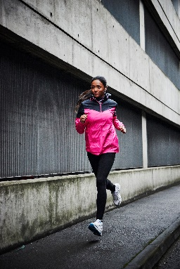
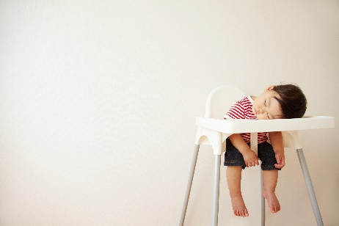
Overview of Clinical Example
Focus on sleep and physical activity in context of weight loss intervention
Unique considerations for each – not all decision points are the same between sleep and physical activity
Generalizability to your research and different types of devices/outcomes
Critical thinking aspects of using wearables
Back and forth with subject matter expert (e.g., validity)
Question and check all assumptions

Slide 26
Reproducible Data Processing

Slide 27
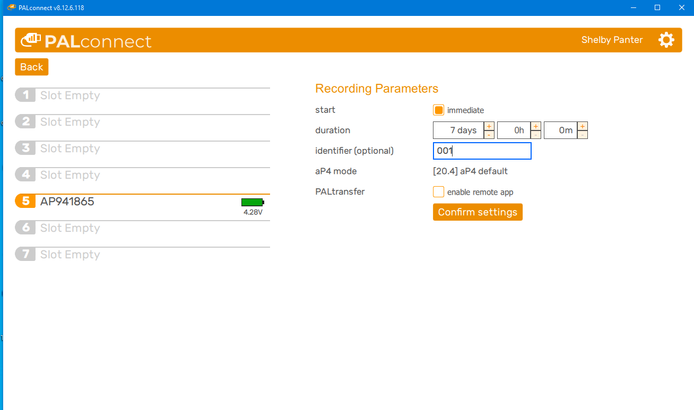
Preface- on the investigator’s side- SETUP

Slide 28
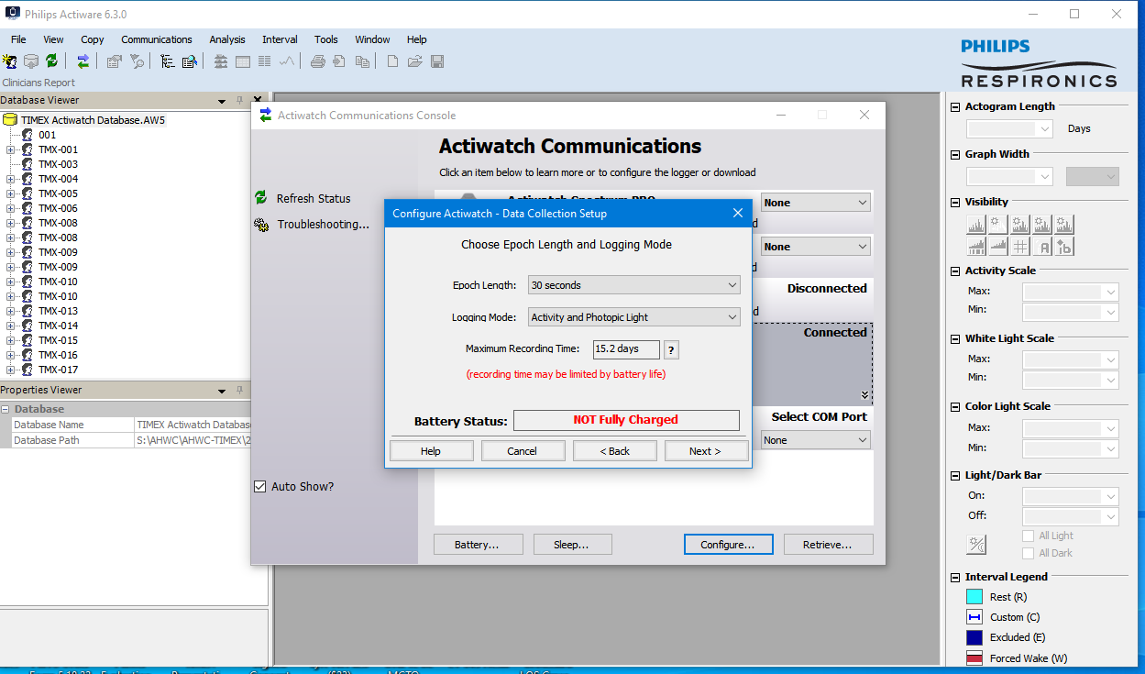
Preface- on the investigator’s side-SETUP

Slide 29
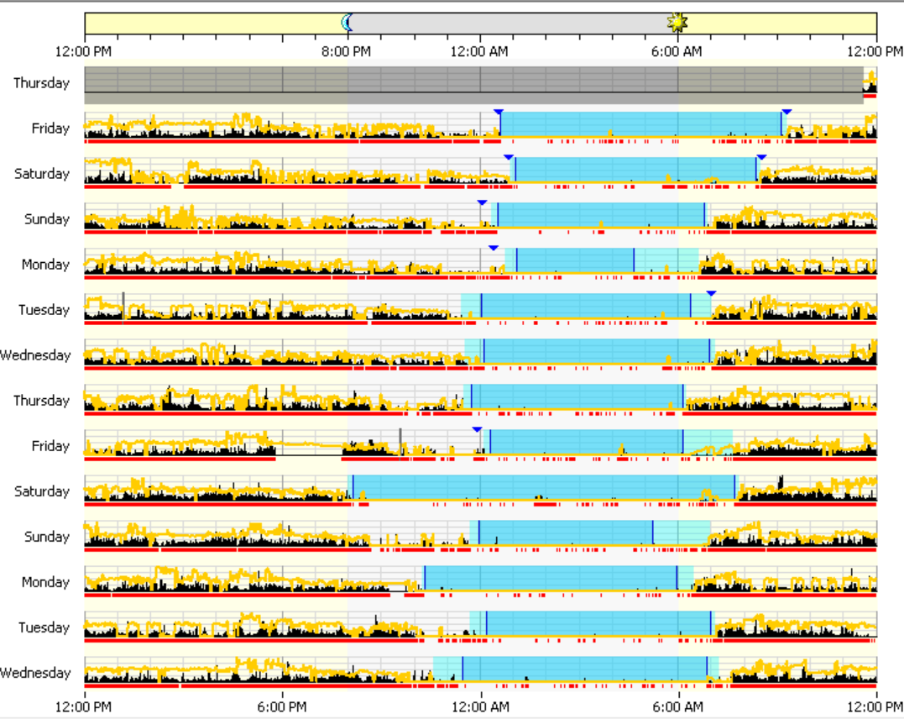
Preface- on the investigator’s side-POST

Slide 30
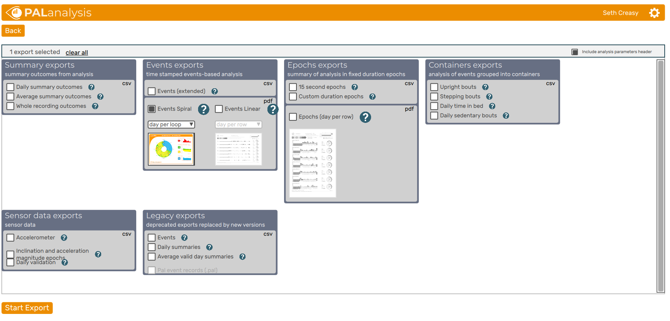
Preface- on the investigator’s side-POST

Slide 31
Preface- on the investigator’s side
The main idea here is…

Slide 32
Our Motivating Example
Longitudinal study: 0, 13, 26, 52
Randomized group
0=Reduced Calorie Diet
1=Reduced Calorie Diet + Physical Activity
Outcomes of interest:
Weight loss, physical activity

Slide 33
Types of Data Files
Summary File
-One record per person per day (or equivalent)
Event File
-One record per person per event
Epoch file
-One record per person per epoch

Slide 34
Which do you need? – It depends…
Summary File
-One record per person per day (or equivalent)
Event File
-One record per person per event
Epoch file
-One record per person per epoch

Slide 35
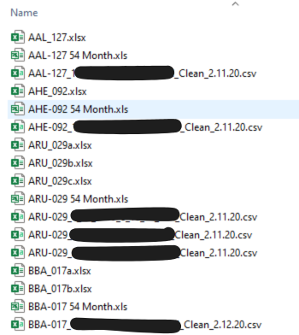
Organization of data- How it started…

Slide 36
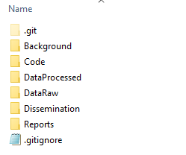
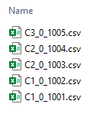
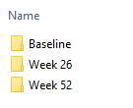
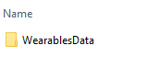
Organization of data- How it is going…
I’d probably call this by the device name
Recommendations:
Data Raw Folder
Wearable-specific folder
One folder per timepoint (or other study-specific strata)

Slide 37
Organization of data- Naming conventions
Train your investigators to have a consistent naming structure for all wearables files
Example:
CohortNumber_timepoint_participantid_otherinfo.csv

Slide 38
Organization of data- Things to look out for
Type of file
Make sure all the files in the folders have the same time intervals (epochs)
Do all the files have the same variables? -_-
If there is no participant id in the file, make sure there is one file that clearly documents the device number and patient using the device at a given time
Repeat Files
Device Malfunctions

Slide 39
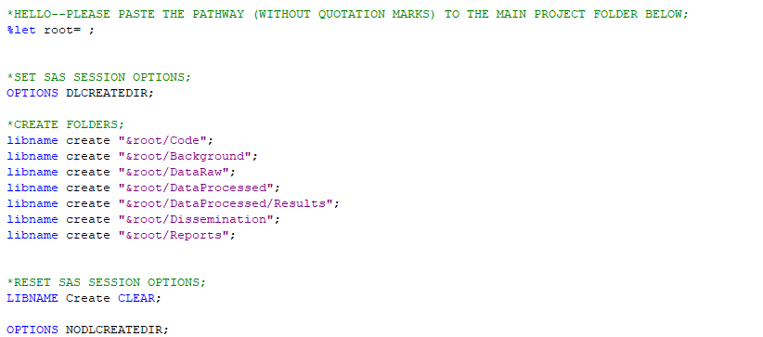
Programmer’s Tip: Automate your folder creation!
CSP2024_Program1_CreateFolders.sas

Slide 40
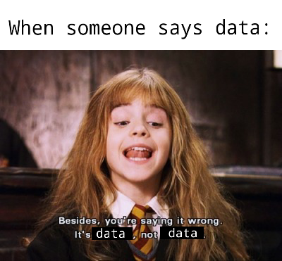
Importing Wearables Data

Slide 41
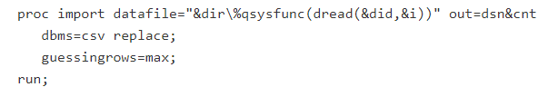
Programmer’s Tip: Automate the import!
Find macros/packages that automate for you!
Automate how you read in all the files— %drive
While knowing between-device differences

Slide 42
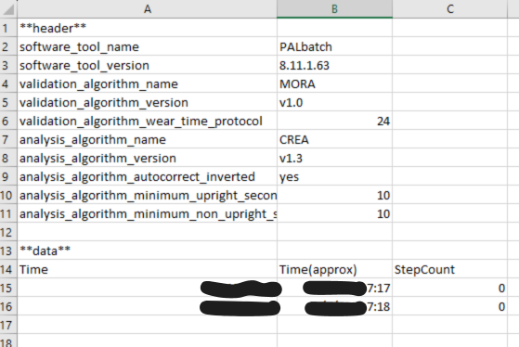
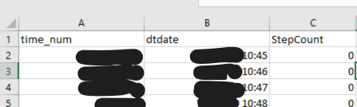
Programmer’s Tip: Automate the import *Carefully!
This is the important part.
While knowing between-device, between-investigator, between-project differences… In other words, LOOK at the raw data☺
Both of these are from ActivPal

Slide 43
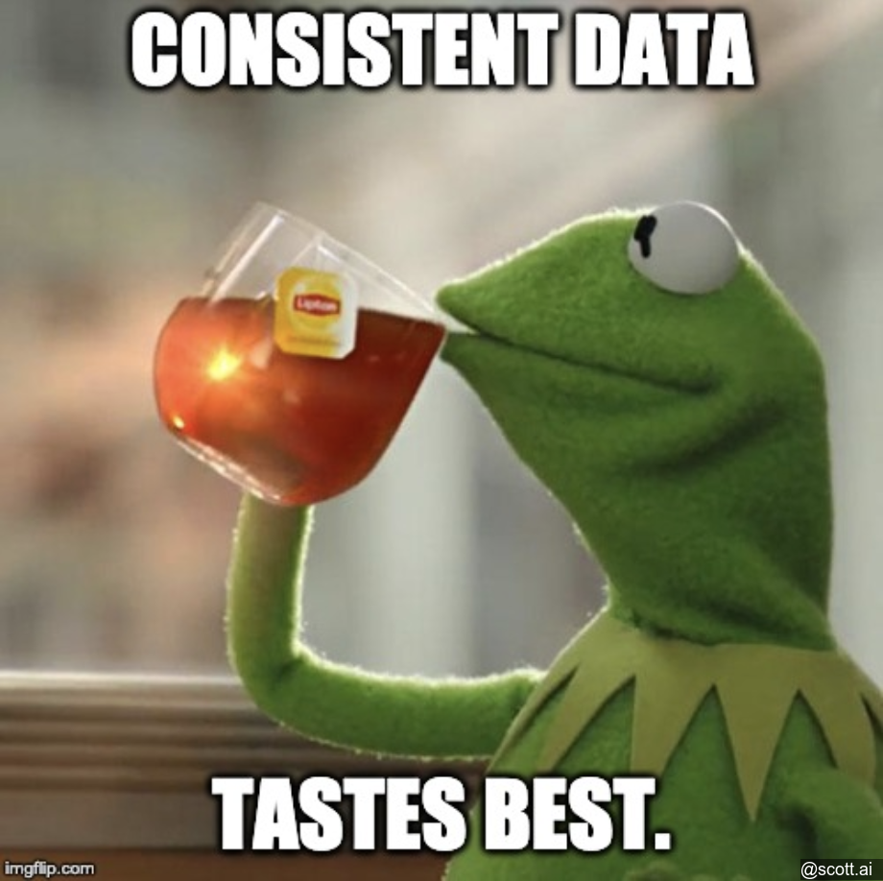
Programmer’s Tip: Automate the import *Carefully!
This is the OTHER important part.
In other words, CHECK the data you read in…
Inconsistencies that have surprised me:
Epochs are different (some are 30s, some are 1 minute)
Variables are different
First row of data is different in every file

Slide 44
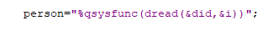
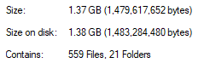
Importing Wearables Data – Other tips
Create a variable in the dataset with the filename
Create permanent versions of the files—so you only have to run your program once
Know (enough) about your computer/memory

Slide 45
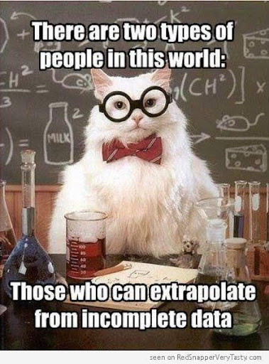
What is valid data?

Slide 46
Valid Data Questions:
Do you have everyone you expect?
Ask for a file with participant IDs, randomized group, study visit, withdrawal, etc.
Do you have repeat files for those expected?
Participant ID | Randomized Group | Study Visit | Withdrawal Visit
1001 | A | 0 | 5
1001 | A | 13 | 5
1002 | B | 0
1002 | B | 13
1003 | A | 0

Slide 47
Valid Data Questions:
How do you define a valid day?
There are 1,440 minutes in one day. How much wear does a person need to have for you to consider you have enough information to speak to their sleep? Physical activity? Glucose variability?
 |  |  | | | | | | ||||
00:00
24:00

Slide 48
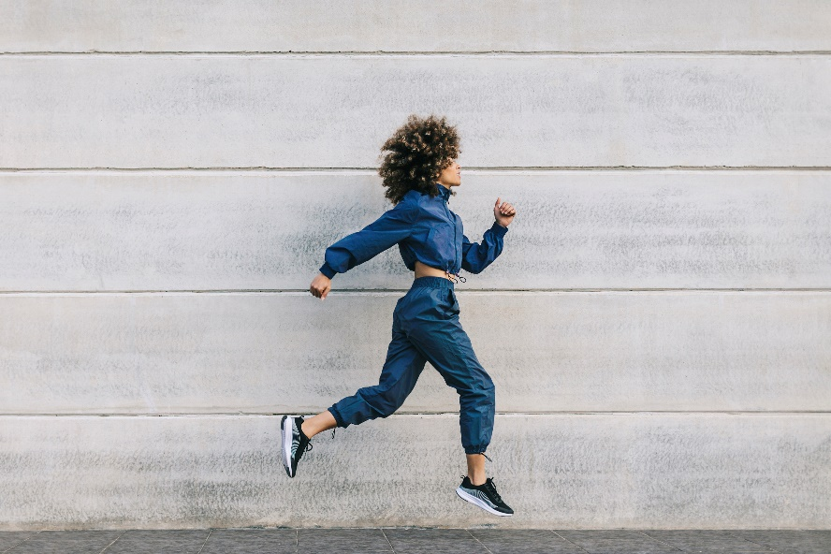
Valid Data Questions:
Legend
Sleep
Active
Sedentary
No Data
How do you define a valid day?
 |  |  | | | | | | ||||
00:00
24:00
 |  |  |  | ||||
 |  |  | | | | | | ||||

Slide 49

Valid Data Questions:
Legend
Sleep
Active
Sedentary
No Data
How do you define a valid day?
 |  |  | | | | | | ||||
00:00
24:00
 |  |  |  | ||||
 |  |  | | | | | | ||||

Slide 50
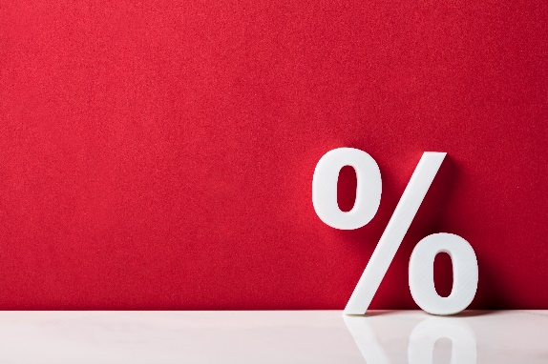
Valid Data Questions:
How do you define a valid day?
Considerations:
Some devices cannot be removed, others can.
Why do people remove devices?
When is the missing data?
 |  |  | | | | | | ||||
00:00
24:00
95

Slide 51

Programmer’s Tip: Automate the valid data checks!
CSP2024_Program2_ValidData.sas

Slide 52
Valid Data Questions:
This really varies by study—so no automation.
How do you define a valid wear period?
If our study had participants wear a device for 7 days,
In an ideal world, our data would look like this:
What happens if it looks like this?
Sunday | Monday | Tuesday | Wednesday | Thursday | Friday | Saturday
1,440 | 1,440 | 1,440 | 1,440 | 1,440 | 1,440 | 1,440
Sunday | Monday | Tuesday | Wednesday | Thursday | Friday | Saturday
1,440 | 984 | 1,235 | 855 | 1,440 | 1,300 | 500
Notes:
Rent – How many minutes…. MEME

Slide 53
Valid Data Questions:
How do you define a valid wear period?
Other considerations:
Weekday vs Weekend days
Shiftworkers
Irregular sleep and waketimes
Normal behavior
Inclusion criteria
Notes:
This should be a normal week for you

Slide 54

What questions do you have?
Notes:
45

Slide 55
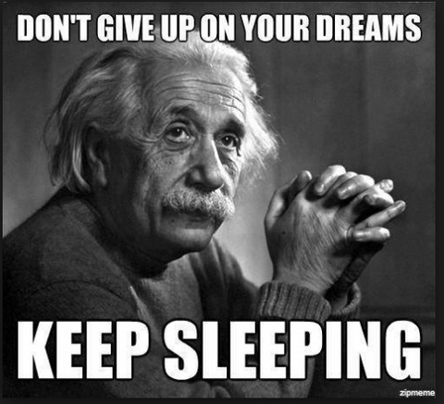
Definitions of Physical Activity & Sleep

Slide 56
Definitions of Physical Activity & Sleep
Devices used for Physical Activity:
ActivPal(Movement + Posture –thigh)
Armband (Movement+Skin Temp+Heat flux+ timestamp button—Tricep/Upper arm)
Devices used for Sleep:
ActiWatch (Movement + Light Sensor + timestamp button)
Notes:
Consumer devices – no easy access to raw data, data privacy concerns (cloud, HIPPA, etc)
$500+

Slide 57
Definitions of Physical Activity & Sleep
One metabolic equivalent (MET) is defined as the amount of oxygen consumed while sitting at rest and is equal to 3.5 ml O2 per kg body weight x min.
Notes:
Jetté M, Sidney K, Blümchen G. Metabolic equivalents (METS) in exercise testing, exercise prescription, and evaluation of functional capacity. Clin Cardiol. 1990 Aug;13(8):555-65. doi: 10.1002/clc.4960130809. PMID: 2204507.

Slide 58
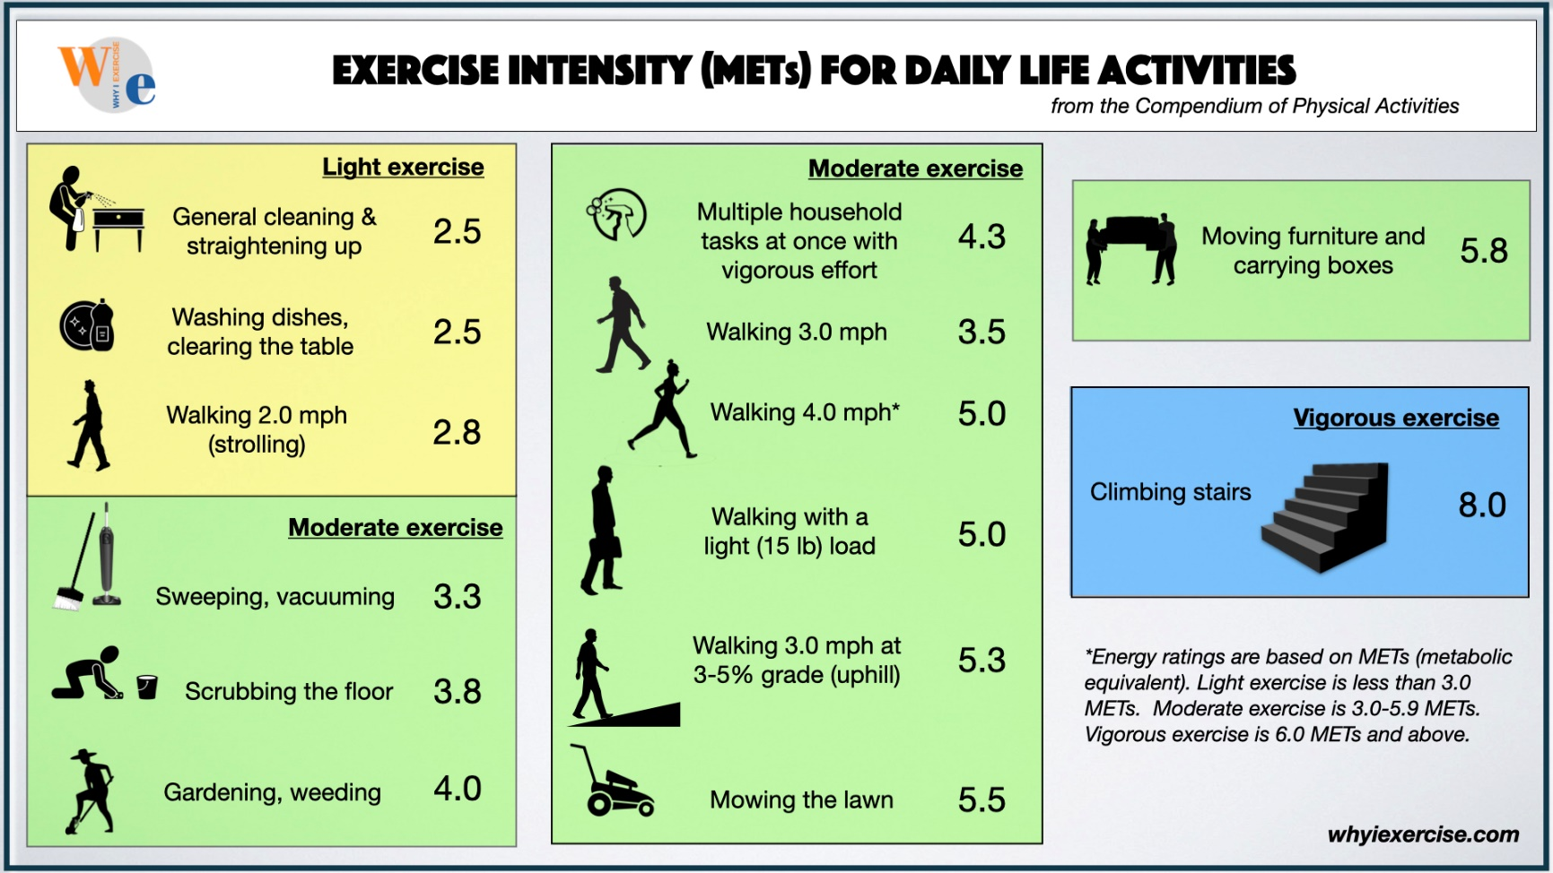
Definitions of Physical Activity & Sleep
LPA
>1.5 and <3
VPA
>6
MPA
>3 and <6
Sedentary <1.5
Exclude Sleep!

Slide 59

Programmer’s Tip: Automate the variable creation
CSP2024_Program3_PA.sas

Slide 60
Definitions of Physical Activity & Sleep
 |  |  |  |  |  | | | | | | | | | |
12:00
24:00
11:59
Sleep Onset
Sleep Offset
Midpoint of Sleep
Legend
LPA
Sedentary
Sleep
Awake during Sleep Window | | |
Total Sleep Time

Slide 61
Definitions of Physical Activity & Sleep
 |  |  |  |  |  | | | | | | | | | |
12:00
24:00
Waketime
11:59
Bedtime
Time in Bed
Legend
LPA
Sedentary
Sleep
Awake during Sleep Window | | |

Slide 62
Definitions of Physical Activity & Sleep
 |  |  |  |  |  | | | | | | | | | |
12:00
24:00
11:59
Wake After Sleep Onset (WASO): Minutes awake during sleep window
Legend
LPA
Sedentary
Sleep
Awake during Sleep Window | | |

Slide 63
Definitions of Physical Activity & Sleep
Other considerations:
Sleep logs
Naps
Notes:
Recommend doing it –helpful for validating data
Using redcap/text messaging vs paper log – advances in technology to reduce the burden and enhance quality of data
More complete data with text messaging

Slide 64
Definitions of Physical Activity & Sleep
How do you know if something weird happened?
Number of epochs– less and more than you’d expect
Number of people
No sleep
No physical activity
Really high values of variables of interest

Slide 65

Beyond Physical Activity & Sleep
Talk with your Subject Matter Experts!
What behaviors are expected in the data?
What would be surprising?
What patterns do they expect to see?
What are some things about the participants that may lead to wearable malfunction/incorrect data?
This Photo by Unknown Author is licensed under CC BY-NC-ND

Slide 66

Summarizing and Visualizing Data
This Photo by Unknown Author is licensed under CC BY-SA

Slide 67
Summarizing and Visualizing Data
Before inference, you should know:
Who is in your data? Who is not in your data? What is the distribution of your outcome? Do your descriptive statistics align with your hypotheses? How does your outcome appear to change over time? Is there anything about your data you should consider in your analysis?

Slide 68

Programmer’s Tip: Automate your Table 1
What variables are commonly used in a Table 1? Do you have certain projects that always use the same 10-15 variables?

Slide 69

The tables and figures you make should align with your research question…
This Photo by Unknown Author is licensed under CC BY-SA

Slide 70

Visualizing the epoch data
CSP2024_Program4_EpochPlots.sas

Slide 71

Checking distributional assumptions
CSP2024_Program5_Distributions.sas

Slide 72

Waterfall plot
CSP2024_Program6_WaterfallPlot.sas

Slide 73
Clock times!
Bedtime | Waketime
00:03 | 08:20
23:45 | 9:30
21:00 | 6:00
Bedtime | Waketime
0.05 | 8.33
23.75 | 9.50
21.00 | 6.00

Slide 74
Clock times!
Bedtime | Waketime
0.05 | 8.33
23.75 | 9.50
21.00 | 6.00
Average bedtime is not:
0.05+23.75+21.00
3
Average bedtime is:
24.05+23.75+21.00
3

Slide 75
Clock times!
Bedtime | Waketime
0.05 | 8.33
23.75 | 9.50
21.00 | 6.00
This impacts any averages, calculations of midpoint of sleep, etc.
Automate the transition
Clock Times-> Decimal Times->Average Decimal Times-> Average Clock Times

Slide 76
Change over time
Measure | Week | All | Change from baseline | Randomized Group 1 | Change from baseline | Randomized Group 0 | Change from baseline
Step Count | 0 | 7134.3 (2313.0) |  | 7394.4 (2378.1) |  | 6924.4 (2248.1)
 | 13 | 8940.9 (2996.4) | 1520.5 (2519.2) | 9405.0 (3006.3) | 1649.7 (2434.8) | 8643.1 (2974.4) | 1437.6 (2586.6)
 | 26 | 8841.5 (3011.8) | 1347.8 (2381.9) | 9303.6 (3029.9) | 1449.4 (2647.1) | 8564.3 (2986.7) | 1286.8 (2224.1)
 | 52 | 8615.5 (3074.0) | 1111.2 (2834.5) | 9466.0 (3031.4) | 1447.7 (3011.4) | 8099.1 (3009.8) | 906.9 (2729.1)
Weight (kg) | 0 | 99.2 (15.8) |  | 97.2 (15.6) |  | 100.9 (15.8)
 | 13 | 91.9 (15.8) | -6.6 (6.3) | 92.4 (15.9) | -4.8 (5.1) | 91.5 (15.8) | -8.0 (6.8)
 | 26 | 92.7 (15.8) | -5.9 (7.8) | 93.2 (14.3) | -3.7 (6.6) | 92.4 (16.8) | -7.4 (8.2)
 | 52 | 92.4 (16.0) | -4.3 (8.3) | 93.9 (14.6) | -2.6 (7.8) | 91.3 (17.0) | -5.4 (8.5)
Energy intake (kcals) | 0 | 1703.8 (474.9) |  | 1626.5 (410.6) |  | 1772.1 (517.8)
 | 13 | 1329.7 (383.0) | -383.9 (416.9) | 1521.9 (301.7) | -173.8 (301.6) | 1182.5 (374.8) | -548.0 (422.5)
 | 26 | 1314.0 (411.1) | -421.4 (433.6) | 1461.9 (375.7) | -264.1 (452.6) | 1212.2 (406.0) | -538.6 (382.3)
 | 52 | 1343.1 (442.5) | -385.3 (475.2) | 1538.0 (376.1) | -148.7 (469.1) | 1205.9 (437.0) | -565.1 (398.0)
CSP2024_Program7_Descriptives.sas

Slide 77

Spaghetti Plots
CSP2024_Program8_SpaghettiPlots.sas

Slide 78
Top two things my investigator wished statisticians knew before working with him:
It is going to be a lot of back and forth communication –collaboration!!
Challenges of working with clock time data and irregular behavior

Slide 79

Top 5 Things I wish someone had told me before I started working with wearables

Slide 80

Organize your folders early and often.

Slide 81

Processing time may be long—make sure you have the right computer.
This Photo by Unknown Author is licensed under CC BY-SA

Slide 82

Being an expert in one does not make you an expert in others… but it does help you think critically.
This Photo by Unknown Author is licensed under CC BY-NC

Slide 83

Spend the time to automate on your FIRST project!

Slide 84

It takes ten times as long as you wish it did—but if you get involved in the study EARLY—you (may) get the data exactly how you need it.
Train your SME.
This Photo by Unknown Author is licensed under CC BY-SA

Slide 85
Modeling and Interpretation

Slide 86



Slide 87

The Plan

Slide 88


Slide 89




Common Wearables Research Questions
Does the outcome change?
Are there group differences in the outcome?
How does the outcome change over time?
How is change in one outcome related to change in a second outcome?

Slide 90

You have options
Two sample t-test
General linear models
Mixed effects models
Growth curves
This Photo by Unknown Author is licensed under CC BY-SA-NC

Slide 91

Missing Data
Characterize missingness
What
How much
Why
Patterns
AI generated

Slide 92



Missing Data
Overall
Control
Treatment

Slide 93



Missing Data
Overall
Control
Treatment

Slide 94


Visualize Missing Data

Slide 95


Data structure
Wide Structure
Each row is a participant
Participant is unit of analysis
No time variable
Multivariate
ANOVAs
Data manipulation
Long Structure
Each row is a time point
Occasion is unit of analysis
Time variable (week)
Univariate
Mixed Models, Plotting
Time specific covariates

Slide 96


Slide 97


Quick review of our hypothetical study
Longitudinal study with 4 timepoints: 0, 13 wks, 26 wks, 52 wks
Randomized group
0=Reduced Calorie Diet
1=Reduced Calorie Diet + Physical Activity
Outcomes of interest:
Weight loss, physical activity

Slide 98

Two sample t-test
Research question?
Do people in the intervention group increase/decrease physical activity more than control?
Hypothesis
$H0: μ_{Δc}=μ_{Δt}$
$H1: μ_{Δc}≠μ_{Δt}$ (or $μ_{Δc}<μ_{Δt}$ or $μ_{Δc}>μ_{Δt}$ )

Slide 99


Two sample t-test
Create a change variable
MVPA at week 52 minus MVPA at week 0
Complete case analysis
Listwise deletion

Slide 100



Two sample t-test
Assumptions
Data is continuous
Independent observations
Randomly selected
Normally distributed
Equal variance

Slide 101


Two sample t-test
Hypothesis
Significance level
Tails
Grouping variable
Outcome variable(s)

Slide 102


Two sample t-test
Group means
Mean difference
t-value
p-value

Slide 103


Two sample t-test
There was a significant difference between the diet only group (M=5.29, SD=14.58) and the diet + exercise group (M=15.57, SD=23.13) in change in physical activity, t(49.14) = 2.33 , p = .02, Cohen’s d = .53.

Slide 104
Two sample t-test debrief
Does this answer an interesting research question?
Does this address the proposed research question?
Are the results easily interpretable?
Are missing observations accounted for?
Does this make good use of the data?

Slide 105


Slide 106







Change scores, Follow-up score or ANCOVA?
(Allison 1990, p. 110)
more options

Slide 107

General linear models
Research question?
Is there a between group difference in physical activity at the end of the study, when controlling for baseline physical activity?
Model Equation
$Y_{T2}=β_{0}+β_{1}X+β_{2}Y_{T1}$
${PA}_{Week 52}=β_{0}+β_{1}Group+β_{2}{PA}_{Baseline}$

Slide 108

General linear models
Outcome variable
Grouping variable
Baseline outcome

Slide 109

Diagnostics
Residuals by Predicted
Influential Observations
Residual Normality
Predicted vs. Observed
Residual-Fit Spread

Slide 110


General linear models
Omnibus test
R-Square
Individual tests
Parameter estimates (regression)

Slide 111

General linear models
There was a significant effect of diet + exercise compared to exercise alone, after controlling for baseline physical activity, F(1, 87) = 8.18, p = .005.

Slide 112
General linear models debrief
Does this answer an interesting research question?
Does this address the proposed research question?
Are the results easily interpretable?
Are missing observations accounted for?
Does this make good use of the data?

Slide 113

The presenter starts talking about mixed effects models for wearables data.

Slide 114

What about Repeated Measures ANOVA?
Sometimes the simplicity of RM ANOVA is preferred
Simple Design
No missing data (or minimal missingness)
Continuous, unbounded outcome
Normal residuals
No clustering
Categorical time
Balanced repeats
Your research question is whether two groups change differently
Can your wearables data do all of these?

Slide 115

What about Marginal Models (GEE)?
Account for dependence of repeated measures
Estimates population averages (no random effects)
Simple nested or repeated measure designs
Does it fit your question, the data, model assumptions?

Slide 116

Characterizing Time
How is your data actually measured?
Is the spacing between measurements equal?
What is your research question?
Is the process linear or non-linear

Slide 117
Characterizing Time
Categorical
Fitting outcome mean at each time point
Spacing doesn’t matter
Continuous
Fitting a line
Accounts for spacing
Change-point models (adoption vs. maintenance)

Slide 118

Visualizing Data

Slide 119

Mixed effects models
Research question?
Does the intervention influence how physical activity changes over time?
Model Equations
$Y_{ti}=β_{0i}+β_{1i}{Time}_{ti}+{β_{2i}{Group}_{ti}+β_{3i}{Time}_{ti}∗{Group}_{ti}+e}_{ti}$
$β_{0i}=γ_{00}+u_{0i}$
$β_{1i}=γ_{10}$
$β_{2i}=γ_{20}$
$β_{3i}=γ_{30}$
${PA}_{ti}=\left(γ_{00}+u_{0i}\right)+\left(γ_{10}\right){Week}_{ti}+\left(γ_{20}\right){Group}_{ti}+\left(γ_{30}\right){Week}_{ti}∗{Group}_{ti}+e_{ti}$

Slide 120

Mixed effects models
Categorical variables
Reference group
Model for mean structure
Time by group interaction
Random effect(s)
Covariance structure
Test for variance in random effects
ID for random effects

Slide 121




Categorical Time
Continuous Time

Slide 122


Categorical Time
Continuous Time

Slide 123


Categorical Time
Continuous Time

Slide 124



Categorical Time
Continuous Time
…

Slide 125
Mixed effects models
ICCs for measurements nested within people was .52.
The variance of the random intercept effect was 177.84, Z = 6.99, p <.0001, indicating significant variability in physical activity between people.
There was a significant interaction between time and group, F(1, 318) = 8.97, p = .003, such that the diet + exercise group increased in physical activity at a faster rate than the diet only group, and the difference between groups was more pronounced at later time points.

Slide 126

Mixed effects models

Slide 127
Mixed effects models

Slide 128
Mixed effects models debrief
Does this answer an interesting research question?
Does this address the proposed research question?
Are the results easily interpretable?
Are missing observations accounted for?
Does this make good use of the data?

Slide 129


Growth Curves

Slide 130
Multilevel or SEM?
Multilevel Framework | Structural Equation Modeling Framework
Measurements across time are nested within individuals | Measurements across time are indictors of latent factors that describe trajectories (i.e., intercept, slope)
Expandable to more than two levels | -
- | Estimate comprehensive measurement models

Slide 131
Parallel process growth curve models
Research question?
What is the relationship between the change in physical activity and change in weight?
Other names: multivariate growth model, correlated growth model

Slide 132


Slide 133

Model for intercept latent variable
Model for slope latent variable
Mean estimation
Variance estimation
Correlation between variables

Slide 134







Slide 135



Slide 136




Slide 137




Slide 138


Slide 139

Added structural components

Slide 140


Slide 141
Parallel process growth curve models
There was a significant group effect on the growth process of physical activity, b = 4.08, Z = 3.68, p < .001, such that the diet + exercise group experienced faster increases than the diet only group.
There was not a significant group effect on the growth process of weight.

Slide 142


Weight
Physical Activity

Slide 143
Parallel process growth curve models debrief
Does this answer an interesting research question?
Does this address the proposed research question?
Are the results easily interpretable?
Are missing observations accounted for?
Does this make good use of the data?

Slide 144

Our Final Take Home Message
Know your “why” for using wearables
Match your research question, data, and statistical model
Spend time and computational resources on data processing
Be patient, everything will take longer than you think
Train your SME

